Slide 1

Data Structures
Andreas Savva
Chapter 2
Stacks

Slide 2
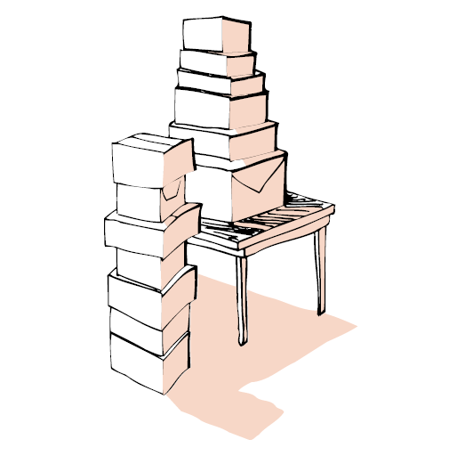
Stacks
A stack is a data structure in which all insertions and deletions of entries are made at one end, called the top of the stack.
The last entry which is inserted is the first one that will be removed. (Last In First Out : LIFO)

Slide 3
Application of Stacks
Page visited history in a Web-browser
Undo sequence in a text editor
Program run-time environment

Slide 4
Pushing and popping a stack
Push box A onto the stack
Push box B onto the stack
Pop a box from the stack
Pop a box from the stack
F
E
Push box C onto the stack
B
D
C
A
Push box D onto the stack
Push box E onto the stack
The Stack
Push box F onto the stack

Slide 5
Implementation of Stacks
Some Basic Operations for Stacks
Create a stack, leaving it empty.
Test whether the stack is Empty.
Retrieve the Top entry from the stack, provided the stack is not empty.
Pop the entry off the top of the stack, provided the stack is not empty.
Push a new entry onto the top of the stack, provided that the stack is not full.

Slide 6
Basic Operations
Create() =
5
Empty =
false
Empty =
true
1
3
5
Error
underflow
Top =
5
Top =
1
3

Slide 7
Basic Operations
5
Error
underflow
Pop =
Pop =
1
1
3
3
2
2
5
5
5
Error
overflow
Push 2, =
Push 7, =
1
1
1
3
3
3

Slide 8
Standard Template Library (STL)
The STL provides convenient implementations for many common data structures.
We can include the STL stack implementation into our programs with the directive:
#include <stack>
And then we can define initially empty stack objects and apply push, pop, top and empty.
In C++, a template constructor allows us to create data structures whose entities have different types:
stack <double> numbers;
stack <int> numbers;

Slide 9
Example using the STL stack
#include <stack>
int main( )
/* Pre: The user supplies an integer n and n real numbers
Post: The numbers are printed in reverse order
Uses: The STL class stack and its methods */
{
int n;
double item;
stack<double> numbers; // Declares and initializes a stack of numbers
cout << ”Enter an integer n followed by n real numbers” << endl;
cin >> n;
for (int i = 0; i < n; i++) {
cin >> item;
numbers.push(item);
}
cout << endl << endl << ”Numbers in reverse: ”;
while (!numbers.empty( )) {
cout << numbers.top( ) << ” ”;
numbers.pop( );
}
}

Slide 10
Information Hiding
The code in a client program should not depend on a particular choice of implementation.
We may first decide to represent a stacks one way and then we may decide that another is better.
If we use information hiding by writing separate functions for manipulating stacks, then only the declarations will need to be changed.

Slide 11
Basic Operations for Stacks
Create a stack, leaving it empty.
Test whether the stack is Empty.
Test whether the stack is Full.
Return the Size (number of entries) of the stack.
Retrieve the Top entry from the stack, provided the stack is not empty.
Pop the entry off the top of the stack, provided the stack is not empty.
Push a new entry onto the top of the stack, provided that the stack is not full.
Print all the entries of the stack.

Slide 12
The Stack Class
class Stack
methods:
Stack (constructor)
empty
full
size
top
pop
push
print
Data members

Slide 13
Stack implementation - Array
typedef double Stack_entry;
enum Error_code {success,overflow,underflow};
const int max = 100;
class Stack {
public:
Stack();
bool empty() const;
bool full() const;
int size() const;
Error_code top(Stack_entry &) const;
Error_code pop();
Error_code push(const Stack_entry &);
void print() const;
private:
int count;
Stack_entry entry[max];
};

Slide 14
Data Structure - Array
Empty Stack:
0
. . .
[0]
[1]
[2]
[max-1]
Push the first entry:
1
*
. . .
[0]
[1]
[2]
[max-1]
n items in the stack:
n
*
*
*
*
*
. . .
[0]
[1]
[2]
[n-1]
[n]
[max-1]

Slide 15
Create Stack
We use a constructor to initialize a new created
stack as empty.
Stack::Stack()
// Pre: None.
// Post: Initialize Stack to be empty
{
}
count
entry
0
. . .
[0]
[1]
[2]
[n-1]
[n]
[max-1]

Slide 16
Empty
bool Stack::empty() const
// Pre: None.
// Post: A result of true is returned if the Stack
// is empty, otherwise false is returned.
{
}
count
entry
0
. . .
[0]
[1]
[2]
[n-1]
[n]
[max-1]

Slide 17
Full
bool Stack::full() const
// Pre: None.
// Post: A result of true is returned if the Stack
// is full, otherwise false is returned.
{
}
count
entry
max
*
*
*
*
*
*
. . .
*
[0]
[1]
[2]
[n-1]
[n]
[max-1]

Slide 18
Size
int Stack::size() const
// Pre: None.
// Post: Return the number of entries in the stack.
{
}
count
entry
n
*
*
*
*
*
. . .
[0]
[1]
[2]
[n-1]
[n]
[max-1]

Slide 19
Top
Error_code Stack::top(Stack_entry &item) const
// Pre: None.
// Post: The top of a nonempty Stack is copied to item.
// A code of underflow is returned if the Stack is empty.
{
}
Top
count
entry
n
*
*
*
*
*
. . .
[0]
[1]
[2]
[n-1]
[n]
[max-1]

Slide 20
Pop
Error_code Stack::pop()
// Pre: None.
// Post: If the Stack is not empty, the top of the Stack is
// removed. If the Stack is empty, an Error code of
// underflow is returned and the Stack is left unchanged.
{
}
count
entry
n-1
. . .
n
*
*
*
*
*
[0]
[1]
[2]
[n-1]
[n]
[max-1]

Slide 21
Push
Error_code Stack::push(const Stack_entry &item)
// Pre: None.
// Post: If the Stack is not full, item is added to the top of
// the Stack. If the Stack is full, an Error code of
// overflow is returned and the Stack is left unchanged.
{
}
count
entry
n+1
*
. . .
n
*
*
*
*
*
[0]
[1]
[2]
[n-1]
[n]
[max-1]

Slide 22
Print
void Stack::print() const
// Pre: None.
// Post: Display the entries of the Stack.
{
}

